Slide 1

Health Care System
Presented by : TEAM 9
Anjali Sajeevan [001563277]
Manasa bhat [001032278]
Sayali Chaudhary [001000217]

Slide 2
ECOSYSTEM
One domain to make patients life easier.
Improved insurance claim process.
Manage and track appointments for multiple enterprises.
Timely tracking of patient history.
Notes:
The purpose of MEDTECH healthcare system is to ensures that all aspects of healthcare come together in one domain to make patients life easier.
It links the insurance to the patient; the insurance claim process is done automatically. It also helps to track and facilitates new drugs, test the drugs and attain FDA approval. Once approved it sends it to the drug manufacture enterprise to be mass produced and be available in the pharmacy.

Slide 3
PROBLEM STATEMENT
Interactions among healthcare entities is a rough road for patients in the existing system.
The hazzle behind the insurance claim process.
Need a single platform for patients to request and track their records.
Proactive analysis of the health risks and medical developments in the community.
Notes:
Health care system is an integral part of our life. Patients being the major consumer in the system, they deal with lot of problems while visiting the hospital, getting lab test reports, procuring medicines and have a separate hazzle behind getting the insurance claims for these requests. There is a need in healthcare where there is a single stop for patients to place all their healthcare requests, track all their records and in turn help hospitals to diagnose them better. With the recent COVID - 19 outbreak, we all are well aware how important it is to proactively analyze the health risks and medical developments in the community. With the recent COVID - 19 outbreak, we all are well aware how important it is to proactively analyze the health risks and medical developments in the community.

Slide 4
SOLUTION
This application is an improved tracking of the healthcare system that will save you a lot of time and resources for all the entities involved in the system.
It will help in proactive monitoring and analysis of the system, that will eventually improve the health conditions, prevent or foresee an epidemic condition.
Each entity in our application has it own share in tracking and providing complete understanding of health risks, medicine demands and vaccine developments in the community. This system will help the health authorities to better analyze the risks and manage the health resources.
This makes MEDTECH healthcare as a whole greater than the sum of its parts.
Notes:
This application is an improved tracking of the healthcare system that will save you a lot of time and resources for all the entities involved in the system.
This will help in proactive monitoring and analysis of this system which eventually help in improving the health conditions and prevent or foresee an epidemic condition.
Each entity in our application has it own share in tracking and providing complete understanding of health risks, medicine demands and vaccine developments in the community. This system will help the health authorities to better analyze the risks and manage the health resources.

Slide 5
OBJECT MODEL DIAGRAM

Slide 6
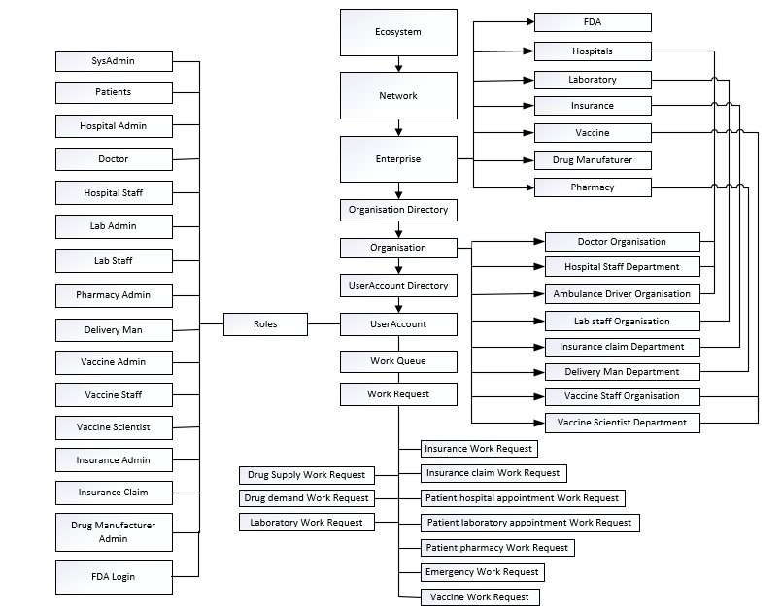

Slide 7
SEQUENCE DIAGRAM

Slide 8
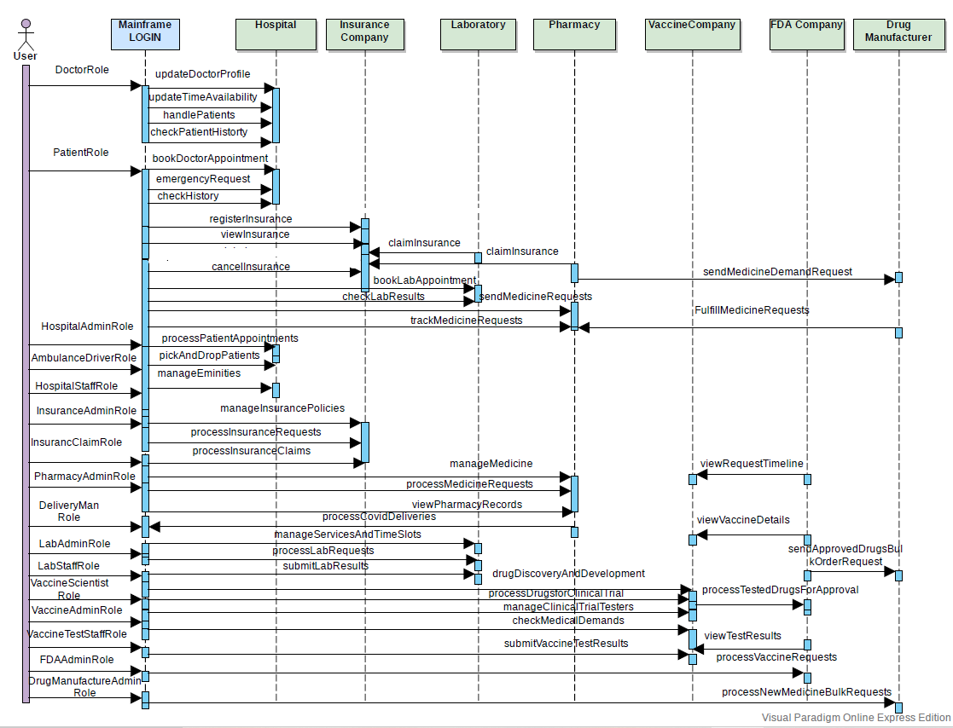

Slide 9
CONCLUSION
Our application provides a better experience for all users of the healthcare system.
It can be further expanded to multiple networks and various enterprise.

Slide 10
Thank you

